Slide 1


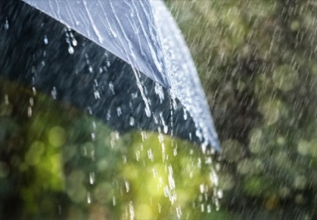
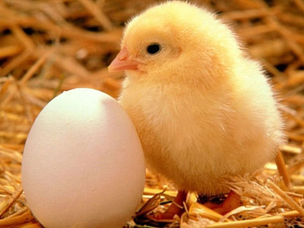
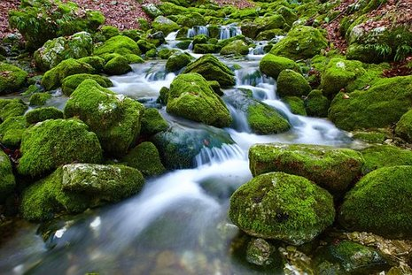

CHANGES
From snow, ice – from ice,
water, from water, snow.
Watch it go!
From a cloud, rain – from rain,
a puddle.
All of a sudden
From a day, a month – from a month,
a year.
Changes are here!
From an egg, a chick – from a chick, a hen.
Watch it begin again!
From a lake, a stream – from a stream, a pond.
From a pond – a calm sea.
Suddenly!
From clay, a brick – from a brick,
a house.
With maybe a mouse!!

Slide 2
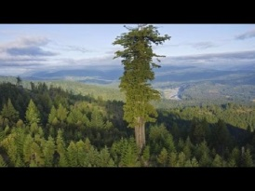
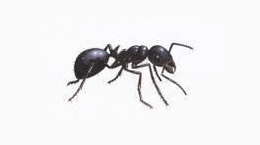
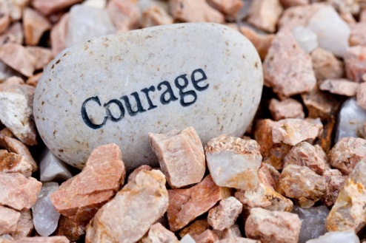
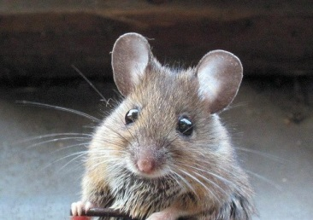

Read Me…
I am a poem.
Read me and you’ll shrink
from the smallest ant,
to the biggest tree.
Every part of you will change.
Your voice and,
as you grow smaller,
will become squeakier than
a mouse.
It would drain your strength
and you will become weaker.
Things change for everyone – life and death!
When you grow your voice will change,
your courage and your love for your friends.
You could reach the
highest door.
You could experience
new things.
It is all about… change!
I am a poem.
Read me and you’ll never be
the same again.
I am a poem.
Read me!

Slide 3
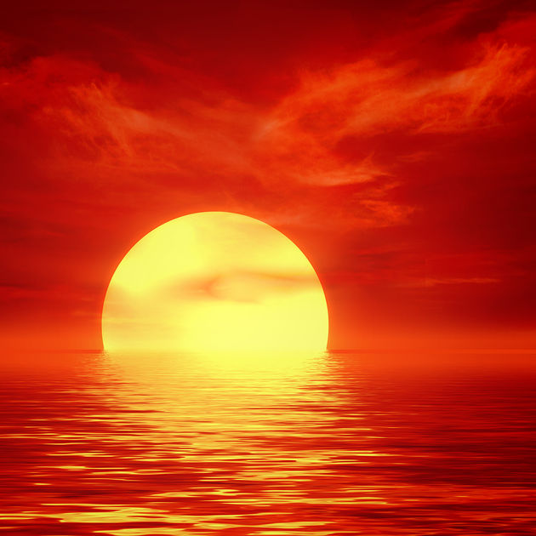
Sunrise, Day, Sunset, Night
It started off sunrise,
half a sun in the sky.
Loads of birds flying high,
red, orange and yellow, too.
There a tree sits through,
cold, warm, fine.
Lots of emotions coming and going,
the whistle of the wind flowing.
Let’s move onto day,
lots of children play.
People climbing trees,
sticks flying everywhere,
just like hair.
Now time is quick,
it goes in a tick.
It’s now sunset
half day, half night.
It can be a fright!
‘cause now it’s night
Say bye to day, animals
Say hi to nocturnal.

Slide 4




Change
Colossal or small, mean or kind,
Everybody can change.
Happy or sad, active or not,
Everybody can change.
Angry or calm, popular or lonely,
Everybody can change.
Naughty or good, selfish or generous,
Everybody can change.
Girl or boy, poor or rich,
Everybody can change.
Everybody can change!

Slide 5
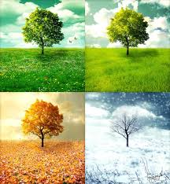
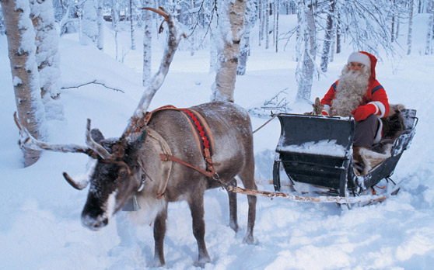
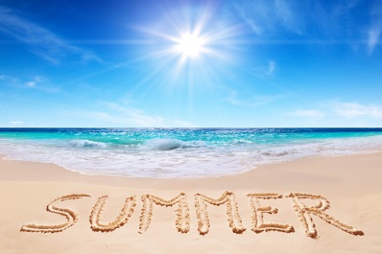
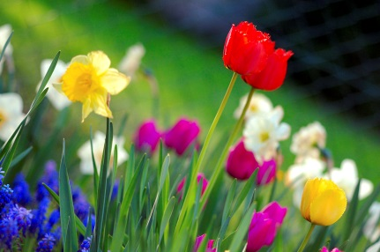
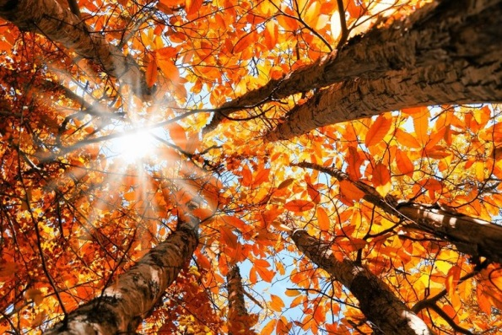
Seasons
Summer is amazing . Now here comes Winter
It is lots of fun with Santa Claus, of course.
splashing in the sea and From the North Pole with presents for all
playing in the sun. with Rudolf and the reindeer
Oh what a galore!
Now next up is Autumn Last of all is Spring
With different coloured leaves. with different coloured wings.
Getting a little chilly From butterflies to birds
but still playing in the breeze and lots of different things.
Flowers in the meadow
and birds that sing all day.
That is the end of the seasons,
HIP HIP HOORAY!

