Slide 1

Welcome to Year 3
Shining light on a world of possibilities

Slide 2
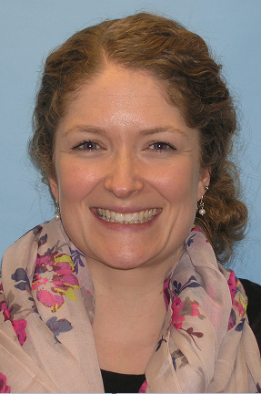
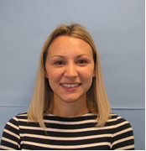
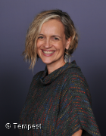
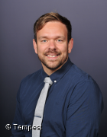
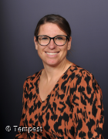
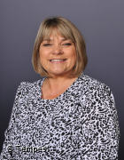
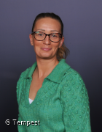
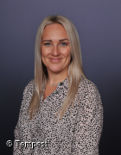
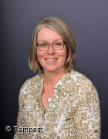
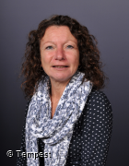
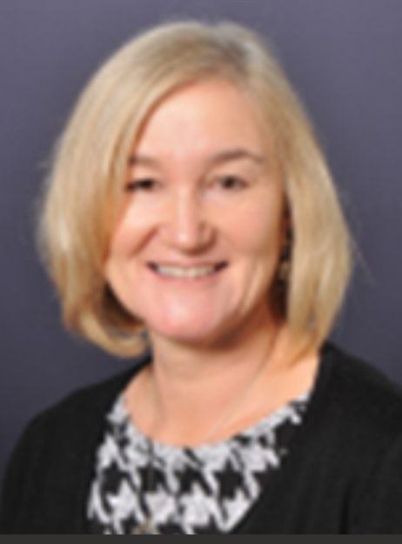
Year 3 Team
Mrs Pitman
Class Teacher
Mrs Denyer
Class Teacher
Mrs Gawen
Class Teacher
Mr Neate
Class Teacher
Mrs Saunders
Learning Support
Mrs Woolley
Teaching Assistant
Mrs Dawes
Learning Support
Mrs Wyton
Learning Support
Mrs Bartlett
Learning Support
Mrs Yensen
HLTA
Mrs Chapman
Learning Support

Slide 3

Useful information
Shining light on a world of possibilities

Slide 4
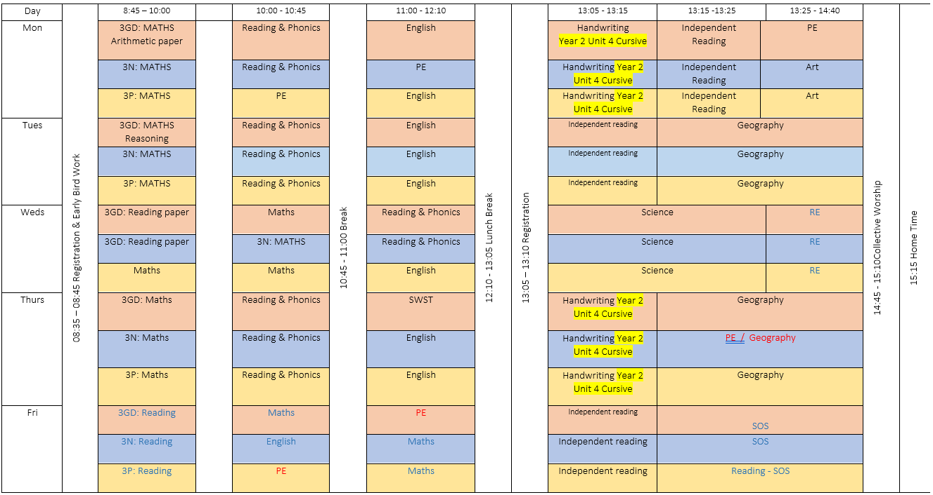
Timetable
Notes:
Sam

Slide 5

Reading
Shining light on a world of possibilities
Notes:
Sammy

Slide 6
Accelerated Reader
In the first few weeks they take an assessment on AR and this gives them a reading range to start with.
It is not expected to read 1 book per night but we do expect that at least 10 minutes of reading will happen.
Once they have scored 100% 3 x, they can potentially move up a level.
If your child, forgets to take their reading book home, they can read a book from home (some books might well be on the AR scheme)
There are also Year 3 reading challenge books for extra reading pleasure.
Children who are still developing their phonics skills will be sent home with a decodable reading book and a book to share.

Slide 7
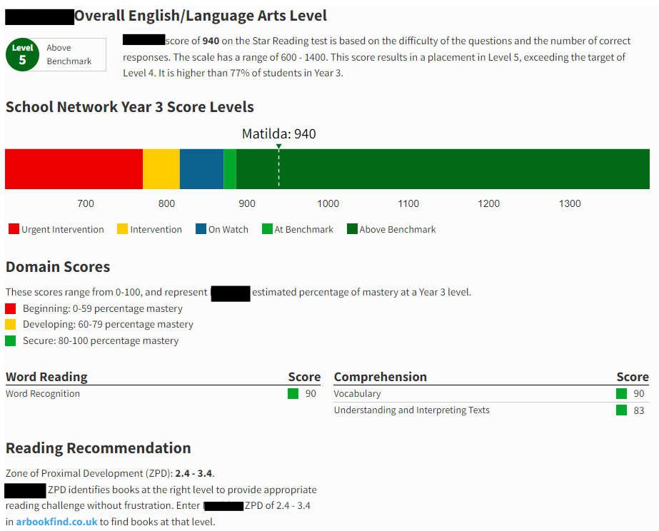

Slide 8
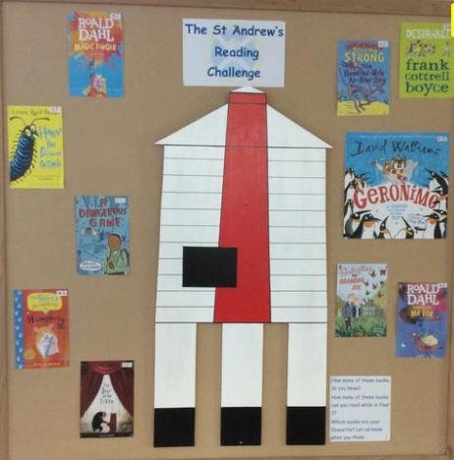
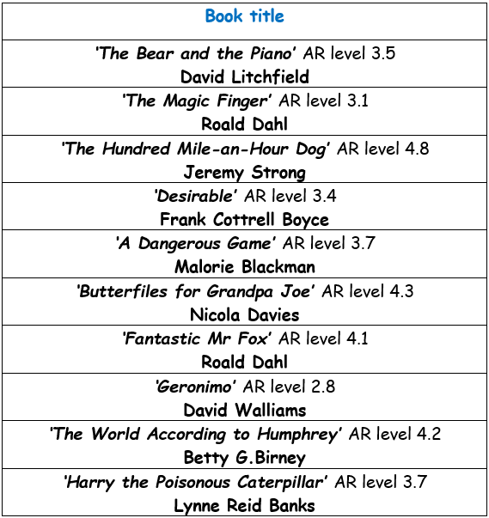
Y3 Reading Challenge

Slide 9
Reading
Please sign planners every weekend and every time your child has read (daily).
Every Friday we will check reading records for reading and parent/guardian signatures and hand out merits.
Please encourage your child to read every night (10 minutes). Four times a week = Merit. This will need to be recorded with a parent signature for merits to be given.
Top tips: learning key words, asking questions about the books that they are reading, reading books of a higher level to them, discussing their last Accelerated Reader quiz.

Slide 10
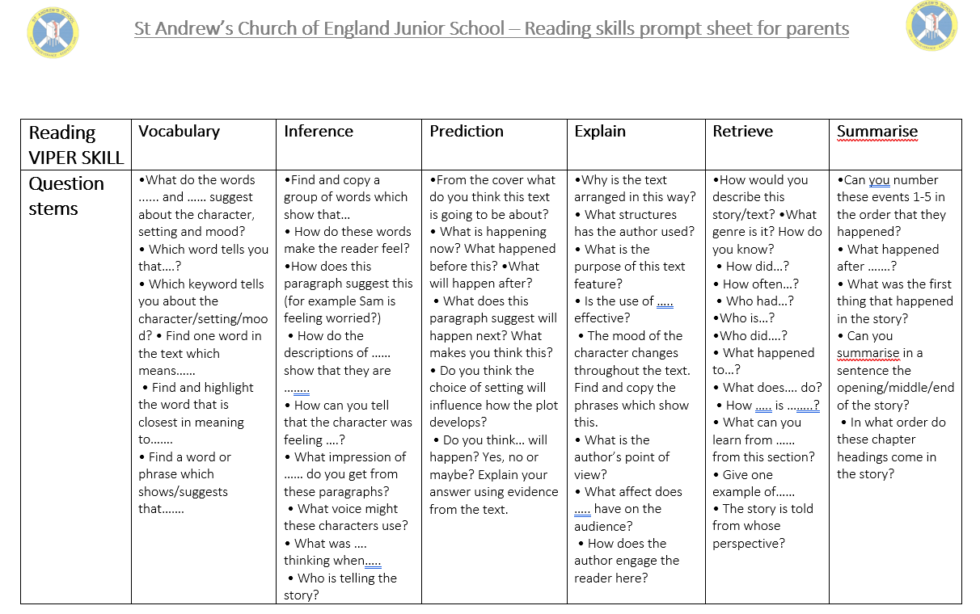

Slide 11

Spellings
Shining light on a world of possibilities
Notes:
Hannah

Slide 12
How they work…
We shall be carrying out a phonic screening when they first arrive in Year 3.
Spelling practice will happen in school as part of the English lessons.
Spellings will be differentiated based on your child's current spelling ability.
Spellings – test on a Friday and the weekly spellings will be stuck into the children’s planner at the start of each term.

Slide 13

Maths
Shining light on a world of possibilities
Notes:
Sam

Slide 14
How Maths works at St Andrew’s…
There will be 5 lessons per week alongside additional fluency lessons.
Times table revision continues to be an important learning goal ready for the Year 4 times table check (more information to follow this slide.)
They will be given a Times Table Rockstars login to help them practise at home.

Slide 15
Y4 Multiplication Times Tables Check (MTC)
The Multiplication Times Tables Check (MTC) is an assessment administered to children in Year 4. It was introduced by the Department for Education as a means to assess pupils' fluency in multiplication facts.
The MTC is a computer-based test where students are presented with a series of multiplication questions. They have a limited amount of time to answer each question by typing in their chosen answer. The questions cover multiplication facts from 2 to 12.

Slide 16
Y4 Multiplication Times Tables Check (MTC)
The primary purpose of the MTC in England is to ensure that students have a strong foundation in multiplication, as this is an essential mathematical skill. The assessment helps identify students who may need additional support in mastering their multiplication tables and informs teaching strategies and interventions.
The MTC results are primarily used at the school level to monitor student progress, identify areas for improvement, and support targeted interventions.
We will be tracking progress with our own weekly MTC check within the class.

Slide 17
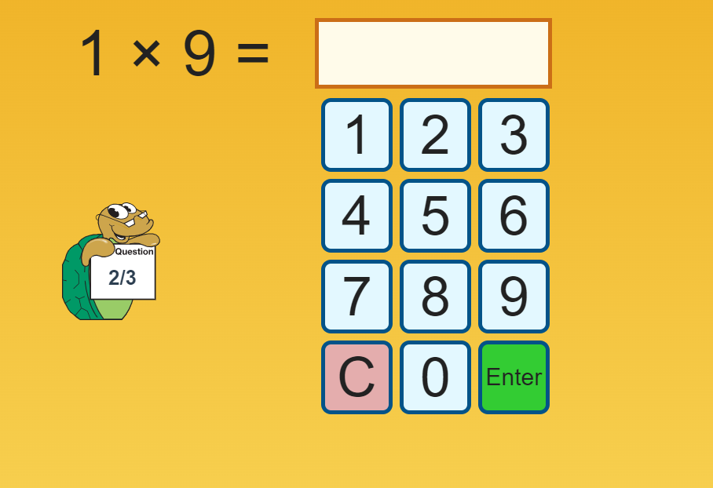
Y4 Multiplication Times Tables Check (MTC)
MTC Test - URBrainy

Slide 18
How can you help?
TTRockstars
Mastery of multiplication tables: Times Tables Rock Stars provides a fun and interactive way for students to practice and master their multiplication tables. Regular use of the platform helps students build fluency and automaticity in recalling multiplication facts.
Expectation
We believe that children need to access TT Rockstars on a regular basis. Our expectation is 35 minutes per week. Some suggested weekly breakdowns are:
5 minutes per day, 7 days a week.
10 minutes per day, 3 days a week + 5 minutes.
35 minutes in one go…
- In Y3, children are expected to complete 3 minutes per day (totalling 21 minutes per week), this is until the beginning of the Spring term where it reverts to the above.
Weekly incentives
- There will be a weekly tournament where classes can compete against each other to be the top class in their year group and across the school.
- There will be a weekly raffle that children will be entered into.

Slide 19

Other subjects
Shining light on a world of possibilities
Notes:
Hannah

Slide 20
Foundation subjects
The afternoons are split in to two lessons. During this time the children get to take part in a variety of subjects such as history, geography, science, art, computing and D&T.
Music - learning to play the glockenspiel.

Slide 21
Homework
Shining light on a world of possibilities
Notes:
Sammy

Slide 22
Foundation subjects
Reading for at least 10 minutes each night.
Spelling practise to be done weekly.
TTRockstars practise for an average of 5 minutes per day/35 minutes per week.

Slide 23
Behaviour
Shining light on a world of possibilities
Notes:
Hannah

Slide 24
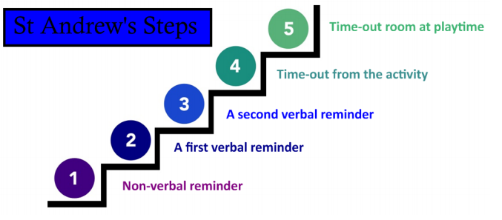
Behaviour and Discipline
Class specific systems
Marbles
Merits
Raffle tickets
Values Award
Star of the Week
We reward good behaviour using a system where the classes names are on the left side of the IWB. A child may have their name moved to the right side around step three. If good choices are made, their name can be moved back. All children on the left side of the board at the end of the day will receive a merit. If all children are on the left side of the board at the end of a lesson the class will earn a marble. They can earn 5 marbles a day. Once all the marbles have been earnt the class will receive a treat.

Slide 25
Other notes
Shining light on a world of possibilities

Slide 26
Other notes
PE kit to be worn on the day your child has PE. Note from adult if unable to take part.
PE hoodies are only to be worn on PE days or on school trips.
Swimming in the Spring term. More information will follow closer to the time.
Children need a named water bottle. They are only allowed water during lesson time but can have squash at lunchtime.
Morning snack (a piece of fruit) to be eaten at breaktime.
Toilet breaks should be during break, lunchtimes and set movement breaks; however, if children are desperate, they can go during lesson time.
Each child will have a planner which they must bring in to school every day.
Notes:
Sam

Slide 27
Communication
Although we are by our doors at the start and end of each day, if you have any concerns, please make an appointment via the school office, or send a message to your child’s class email.
Most communications will be sent via the school app, social media or weekly digital signpost.
We have class pages on the school website- this is a good place to find the weekly timetable, spellings, website links, latest information and also photos of year group activities. On the class pages, you will also find the email you can use to contact your child’s class teacher.

Slide 28
Any questions?
Shining light on a world of possibilities

