Slide 1

St Andrew’s Junior School
Welcome to 5K Magpie

Slide 2

We hope you are well rested after the summer break and are looking forward to Year 5 at St. Andrew’s.
We are excited about the year ahead and getting to know your children. The aim of the next few weeks is to settle the children into any new routines and to ensure that they are happy and comfortable in their new classes.

Slide 3
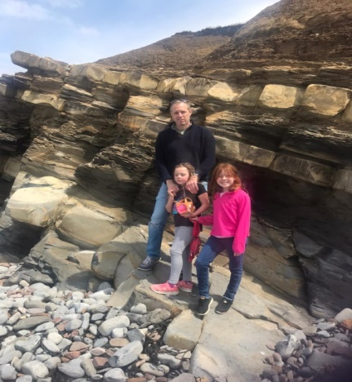
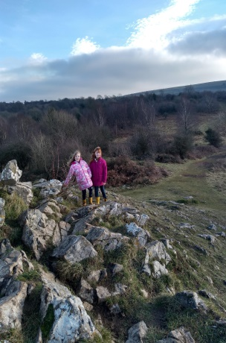
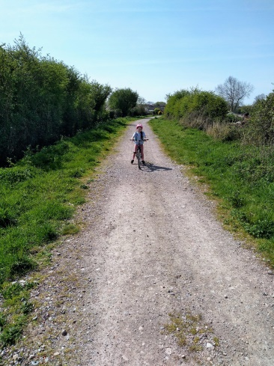
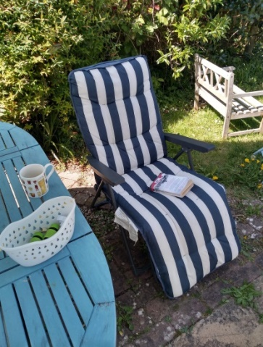
About me
Mr Kendrick
I live in Burnham with my family, so say hello if you see me in Tesco!
I enjoy walking, cycling and reading in the garden.

Slide 4
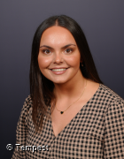
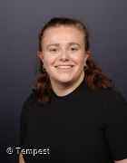
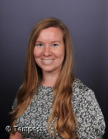

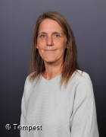
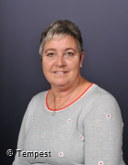

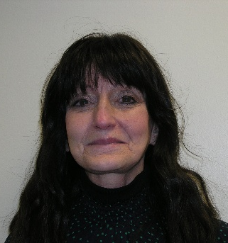
Year 5 Teachers:
Mrs Bunning Miss Lodge/Mrs Kittridge Mr Kendrick
Learning support staff:
Mrs Haines Mrs Clarke Mrs Chapman Mrs Hodgkinson

Slide 5



Zones of regulation, mental health daily activity
Water bottles
Morning snack (later lunch in Year 5)
Healthy lunchboxes
Healthy School Meals
Keeping a bedtime routine
Managing screen time

Slide 6
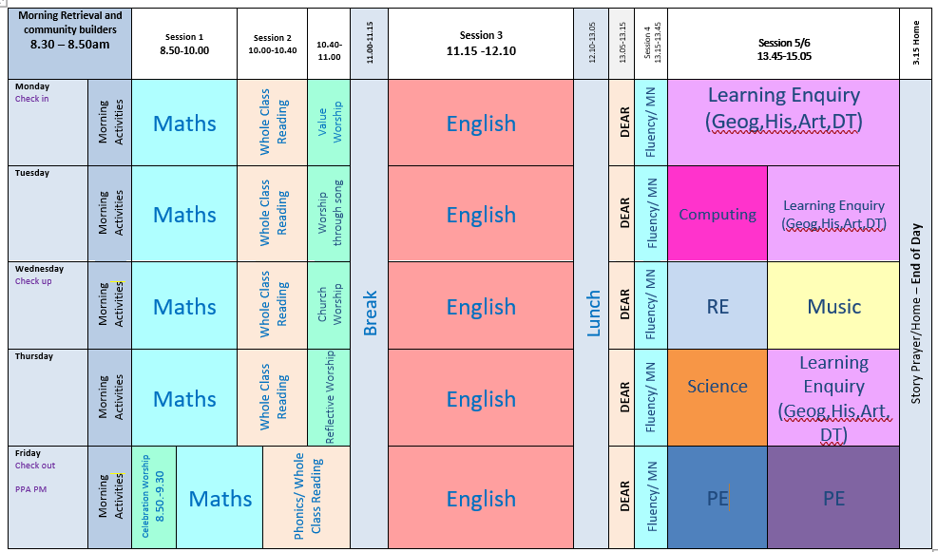
New Timetable – timings of the day (example timetable, some subjects may be taught at different times!)

Slide 7
Year 5 Enquiry work:
Our History, Geography and other foundation subjects are all linked within an enquiry question this year. This helps focus the children’s learning but gets them thinking about key questions.
For the Autumn term it is:
Why do people invade and settle? (Anglo Saxons, Vikings)

Slide 8
Maths
There is limited time to practise timestables in school now being in Year 5 so it is more important than ever to get practising at home! The government expectation is that all children know their timestables up to 12 x 12 by the end of year 4.
A huge amount of the year 5 maths curriculum relies on the children knowing their timestables. Therefore they can find things more difficult if they are still struggling with them.
Like last year, the children will have weekly TT Rockstars homework (35 minutes over the week) which will be checked each Friday.
They will also have a weekly written times tables test to help with their learning on a Friday as well.

Slide 9
Reading
Please sign planners each time your child has read.
Every Friday we will check their planners for reading and parent/guardian signatures
Please encourage your child to read every night (at least 10 minutes). At least 4 times a week = Merit
Top tips: asking questions about the books that they are reading, reading together, discussing their last Accelerated Reader quiz, subtitles when watching the TV.
Accelerated Reader assessments have taken place in the first week back, reading books should have come home already. Some children may be on a lower level than where they were at the end of last year, this is just while they settle in.
Children will take an AR quiz before changing their book. Children will need to ask their teacher before moving up a level.

Slide 10
Spellings
Spellings – One weekly lesson on a Monday where spellings will be given out.
Children will practise their spellings each day in the mornings, but can practise at home as well on the sheet provided.

Slide 11
Homework
TT Rockstars (35 minutes over the week)
Reading daily (4 times a week minimum)
Spellings
Rewards will be given to children who complete all their homework.
Children who haven’t done their homework will be able to complete it at homework club on Wednesdays or Fridays.

Slide 12
Behaviour and Discipline
At St Andrew’s we have a positive approach to behaviour with lots of rewards for the children to praise their hard work and achievements. These include merits, raffle tickets and Star of the week certificates.
However, if children have not been making the right choices there are ways in which we support them to make better choices.
Reflection room – for serious breaches of the behaviour policy or for persistent rule breaking Mrs Collett runs a reflection room every lunchtime where children may be sent if the teacher feels the child needs to spend time speaking to Mrs Collett and reflecting on their choices.

Slide 13
Communication
Although you may see us on the playground during morning and afternoon transitions, we ask that if you need to speak to us you contact the school office to arrange an appointment as it may not always be the most convenient time.
You can email the school office who will pass on your emails to us and we can contact you that way if you prefer.
We have class pages on the school website- this is a good place to find homework, website links, latest information and also photos of year group activities.

Slide 14
School Planners
The school planners have been updated this year to be even more useful and efficient for the children and you.
Please make sure you have a thorough look through as they contain lots of important information about the school year ahead as well as resources to support your child’s learning.

Slide 15
Thank you for listening!
Any questions…
Have a lovely evening ☺

