Slide 1

St Andrew’s Junior School
Welcome to Bramble

Slide 2

We hope you are well rested after the summer break and are looking forward to Year 5 at St. Andrew’s.
We are excited about the year ahead and getting to know your children. The aim of the next few weeks is to settle the children into any new routines and to ensure that they are happy and comfortable in their new classes.

Slide 3
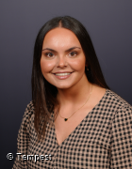
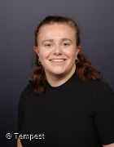
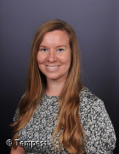
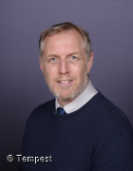
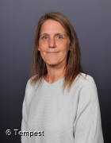
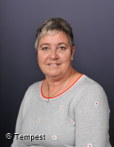

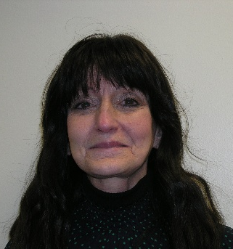
Year 5 Teachers:
Mrs Bunning Miss Lodge/Mrs Kittridge Mr Kendrick
Learning support staff:
Mrs Haines Mrs Clarke Mrs Chapman Mrs Hodgkinson

Slide 4
Miss Lodge: Mondays and Tuesdays
Mrs Kittridge: Wednesdays, Thursdays and Fridays.
When Mrs Kittridge goes on maternity leave, Miss Lodge will be taking over the end of the week.

Slide 5



Zones of regulation, regulation stations, Lighthouse
Water bottles
Morning snack (later lunch in Year 5)
Healthy lunchboxes
Healthy School Meals
Keeping a bedtime routine
Managing screen time

Slide 6
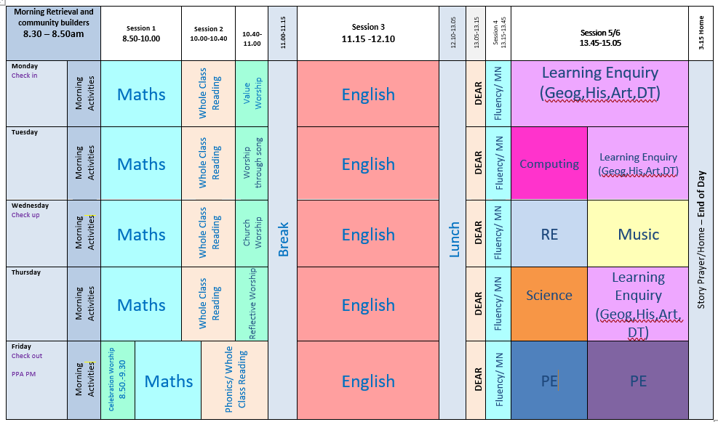
New Timetable – timings of the day (example timetable, some subjects may be taught at different times!)

Slide 7
Year 5 Enquiry work:
Our History, Geography and other foundation subjects are all linked within an enquiry question this year. This helps focus the children’s learning but gets them thinking about key questions.
For the Autumn term it is:
Why do people invade and settle? (Anglo Saxons, Vikings)

Slide 8
Maths
A huge amount of the year 5 maths curriculum relies on the children knowing their timestables. Therefore they can find things more difficult if they are still struggling with them. Your support with completing TT Rockstars is appreciated.
Like last year, the children will have weekly TT Rockstars homework (35 minutes over the week) which will be checked each Friday.
They will also have a weekly written times tables test to help with their learning on a Friday as well.
Flexible groupings: We have started a ‘flexible groupings’ approach this year. Children can be targeted to help progress. They may change throughout the year but any changes will be communicated.

Slide 9
Reading
Please sign planners each time your child has read.
Children will receive merits when they read.
Top tips: asking questions about the books that they are reading, reading together, discussing their last Accelerated Reader quiz, subtitles when watching the TV.
Accelerated Reader assessments have taken place in the first week back, reading books should have come home already. Some children may be on a lower level than where they were at the end of last year, this is just while they settle in.
Children will take an AR quiz before changing their book. Children will need to ask their teacher before moving up a level.

Slide 10
Spellings
Spellings – One weekly lesson on a Monday where spellings will be given out.
Children will practise their spellings each day in the mornings, but can practise at home as well on the sheet provided. We do not need to have the sheet back - it is just to support the process at home if you wish.

Slide 11
Homework:
TT Rockstars (35 minutes over the week)
Reading daily (4 times a week minimum)
Spellings
Rewards will be given to children who complete all their homework.
Children who haven’t done their homework will be able to complete it at homework club on Wednesdays or Fridays.

Slide 12
Behaviour and Discipline
At St Andrew’s we have a positive approach to behaviour with lots of rewards for the children to praise their hard work and achievements. These include merits, raffle tickets and Star of the week certificates.
However, if children have not been making the right choices there are ways in which we support them to make better choices.
Reflection room – Mrs Collett runs a reflection room every lunchtime where children may be sent if the teacher feels the child needs to spend time speaking to Mrs Collett and reflecting on their choices.

Slide 13
Communication
We ask that if you need to speak to us about something you contact the school office to arrange an appointment.
You can email the school office who will pass on your emails to us and we can contact you that way if you prefer.
We have class pages on the school website- this is a good place to find homework, website links, latest information and also photos of year group activities.

Slide 14
Thank you for listening!
Any questions…
Have a lovely evening ☺

